Slide 1

Software Design Principles
SOLID Principles

Slide 2
OO Design
If we need to build Object Oriented systems, which are maintainable, extensible and modular, it would be best done following well known principles and practices as part of the OO design.
These principles will ensure good practices, and when followed will provide loosely coupled classes which will enable minimizing changes in the code, and helps in making code more reusable, maintainable, flexible and stable.
Following the principles reduces complexity as the application sizes grow.
We discussed GRASP (General Responsibility Assignment Software Principles(or Patterns)), which help in providing guidance on assigning responsibilities to collaborating classes & objects, based on their association and their interactions. There were 9 principles of GRASP: Creator, Information Expert, Low Coupling, Controller, High Cohesion, Indirection, Polymorphism, Protected Variations and pure fabrication
Notes:
Static
Class – Objects- Attributes, Behaviour Attributes, Operations Relationship between Classes – Association, Generalization, Dependency and Realization
Components – autonomous units of the system
Component diagram contains parts of the component, Interfaces or connectors, ports or interaction points (has one or more interfaces)
Deployment Diagram: Physical system architecture Nodes –system resources, topology
Dynamic
Activity Diagram: Co-ordinated flow of actions (Steps in the activity) – manipulation, invocations to methods – Splitting for Concurrency – Join – Sequential, Swim lanes grouping of activities so the responsibilities
Sequence : Scenario describes a sequence of the events or messages within an action:
State Diagram: State of the object – depends on the events or signals/operation/passing of time etc.
Activity effects on the behaviour of the objects

Slide 3
SOLID Principles
SOLID is an acronym of the following five basic object oriented design principles listed below initiated by Robert C. Martin
Single Responsibility Principle
Open – Closed Principle
Liskov Substitution Principle
Interface segregation Principle
Dependency Inversion Principle

Slide 4
1. Single Responsibility Principle
The Single Responsibility Principle (SRP) states: “A class should have only one responsibility “. This would mean there would be only one reason to make changes to the code involved post the initial development, thus making the code robust as its likely to have less side effects during maintenance.
In the following example class Class Simulation{
Public LoadSimulationFile() // loading simulation data
Public Simulate() // performing simulation algorithm -
Public ConvertParams() } // this class is handling 2 responsibilities
Since this class has more than one responsibility it has low cohesion. Single responsibility would have made it to be high cohesion
Splitting the above class can bring about higher cohesion but would increase the coupling.. The goal is to have minimal coupling and not 0 coupling .. So this splitting would be acceptable.

Slide 5
2. Open-Closed Principle
The open closed principle states “A software module (it can be a class or method) should be open for extension but be closed for modification” or you could state this as “you should be able to extend a classes behavior without modifying it”
The open-closed principle can be applied through inheritance or through composition
With Inheritance, you don’t have to touch the class you want to extend if you create a subclass of it. The original class is closed for modification but you can add custom code to your subclass to add new behavior.
This principle needs to be applied strategically in those conditions where you suspect a piece of code will change in the future and its not expected to be applied in every scenario as most of the code may not change.

Slide 6
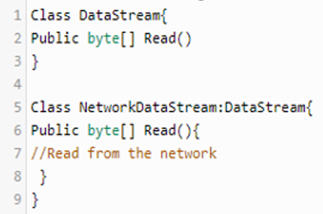
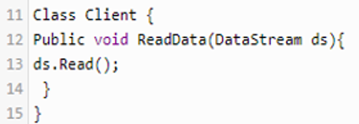
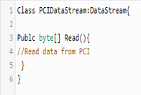
2. Open-Closed Principle : An Example using Inheritance
Consider the classes DataStream, NetworkDataStream and the client. In the class Client, ReadData() comes from the NetworkDataStream
If we need to extend the functionality of the client class to read from another stream the PCIDataStream as shown below
Thus in this scenario, the client code will function without any error. The client class knows about the base class, and I can pass an object of any of the two subclasses of DataStream. In this way, the client can read data without knowing the underlying subclass. This is achieved without modifying any existing code.
Base Class inherited to Client New class inheriting NetworkDataStream again from the base class

Slide 7
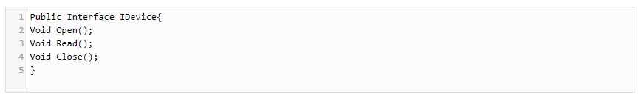
3. Liskov Substitution Principle
The Liskov Substitution Principle states
To elaborate, let’s consider an example, here is an interface whose listing is given below:
Derived classes must be substitutable for their base classes.
This code represents data acquisition device abstraction.
Data acquisition devices differ based upon their interface types.
A data acquisition device can use a USB interface, Network Interface (TCP or UDP), PCI express interface, or any other computer interface.
Clients of iDevice, however, do not need to know what kind of device they are working with.
This gives programmers an enormous amount of flexibility to adapt to new devices without changing the code which depends upon the iDevice interface.

Slide 8
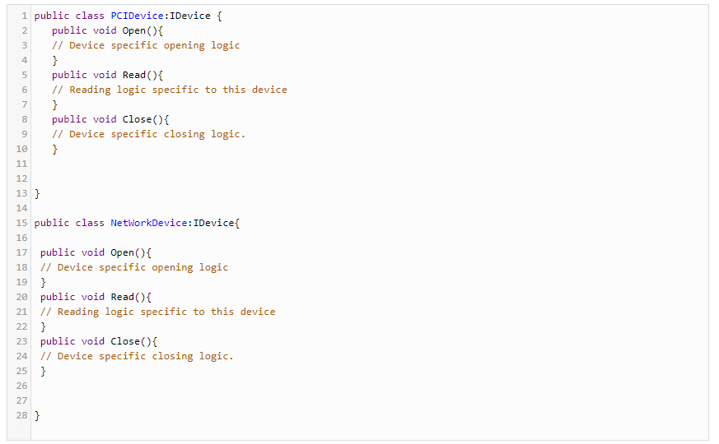
3. Liskov Substitution Principle (Cont.)
Let’s say if there were only two concrete classes that implemented iDevice interface shown below:

Slide 9
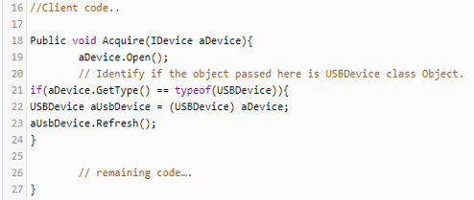
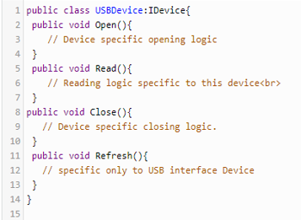
3. Liskov Substitution Principle (Cont.)
This approach has one problem with USB device. In USB device when you open the connection, data from the previous connection remains in the buffer. Therefore, upon the first read call to the USB device, data from the previous session is returned. This behavior corrupts data for that particular acquisition session.
USB-based device drivers typically provides a refresh function which clears the buffers in the USB-based acquisition device. How can I implement this feature into my code so that the code change remains minimal?
One simple, but unadvised, solution is to update the code by identifying if you are calling the USB object:
The client code is directly using the concrete class as well as the interface. So abstraction is not sufficient

Slide 10
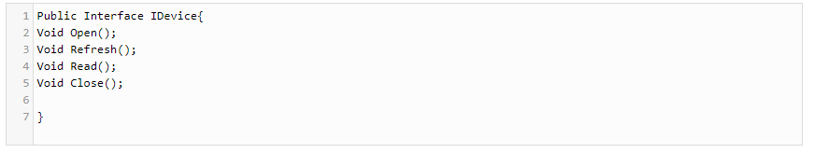
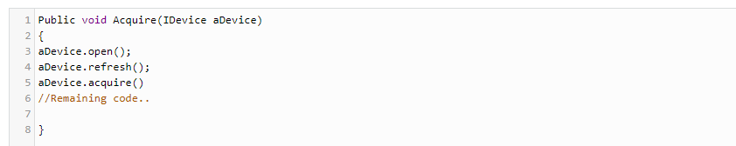
3. Liskov Substitution Principle (Cont.)
Below is a solution to this problem that follows the LSP:
Now the client of iDevice is:

Slide 11
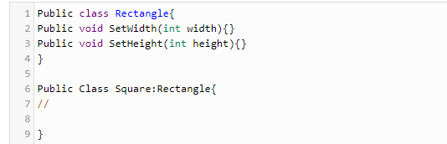
3. Liskov Substitution Principle (Cont.)
Lets consider the example of the rectangle and the square. When looking at it from the outset it looks like the square is a specialized version of the rectangle and we may draw the following inheritance hierarchy:
Unfortunately, you cannot substitute a square object in place of a rectangular object. Since the square inherits from the rectangle, therefore, it inherits its method setWidth() and setHeight().
A client of the square object can change its width and height to different values.
Since width and height of a square is the same, this may fail the normal behavior of the software.
So when defining classes, relationships have to be looked at according to different usage scenarios and conditions

Slide 12
4. Interface Segregation Principle (ISP)
The Interface Segregation Principle (ISP) states:
or
“Make fine grained interfaces that are client specific”
This principle is looking to indicate
Make small and specific interfaces so the client who implements them does not depend on methods it does not need.
Like Instead of having one interface class that can handle three special cases it is better to have three interface, one for each special case.
This is similar to Classes which should be as specialized as possible, like you do not want any god classes that contain the whole application logic or the source code needing to be modular with every class containing only the minimum necessary logic to achieve the desired behavior.
Clients should not be forced to depend upon the interfaces that they do not use.
Notes:
Instead of one class that can handle three special cases it is better to have three classes, one for each special case.

Slide 13
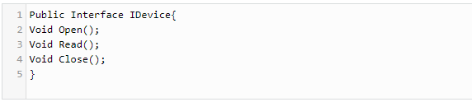
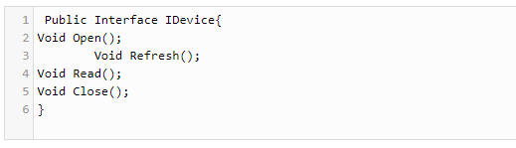
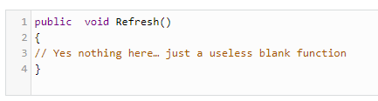
4. Interface Segregation Principle (ISP) (Contd.)
Again consider the previous example:
For example, the following lines of code need to be added to the Network Device class and PCI Device class to work with this design:
This breaks this principle as it is causing unnecessary clients to depend on the same.

Slide 14
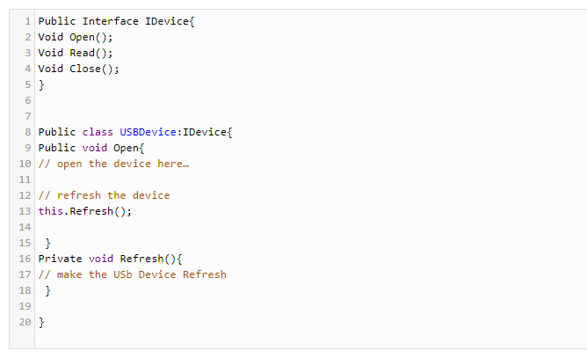
4. Interface Segregation Principle (ISP)
One approach to solve is to use the understanding that refresh occurs after the open function only in USB interface. Thus
refresh logic is moved from the client of IDevice to the specific USB concrete device class as shown here:
Thus this reduces the number of functions in the iDevices class and makes it less fat too.

Slide 15
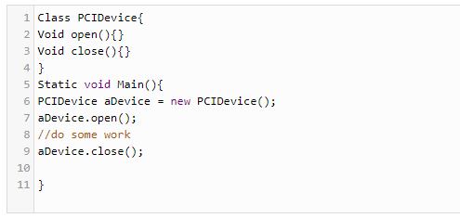
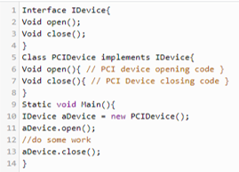
5. Dependency Inversion Principle (DIP)
This principle is a generalization of the other principles discussed above.
Program to an interface, not to an implementation.
Consider following example
This violates the “program to an interface" principle because we are working with the reference of the concrete class PCI Device.
The below listing addresses this

Slide 16
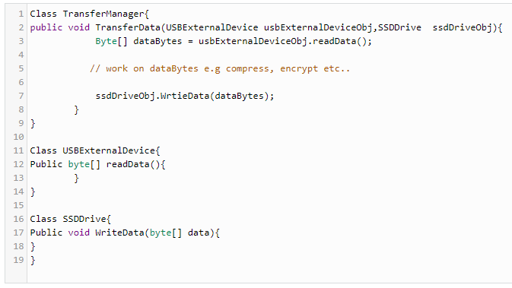
5. Dependency Inversion Principle (DIP) (Cont.)
High-level modules should not depend upon low-level modules. Both should depend upon abstractions.
Consider the following code
Say, this is for transferring data from a source (external device) to a storage device (internal device).
In this code, there are three classes.
The Transfer Manager class represents a high-level module as it uses two classes in its one function. Hence the other two classes are low-level modules.
The high-level module function (Transfer Data) defines logic based upon how data is transferred from one device to another device.
Any module which is controlling the logic, and uses the low-level modules in doing so, is called the high-level module.
In the code above, the high-level module is directly (without any abstraction) using the lower-level modules, hence violating the dependency inversion principle.
if you want to add other external devices you will have to change the higher-level module. Hence your higher-level module will be dependent upon the lower-level module, and that dependency will make the code difficult to change.

Slide 17
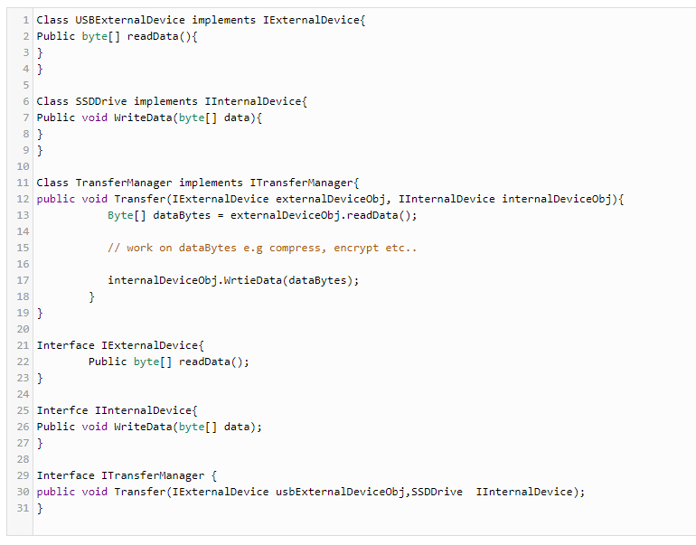
5. Dependency Inversion Principle (DIP) (Cont.)
The solution is easy if use the principle above: "program to an interface." Here is the listing:
Since in the code, both high level module and the low level module depend upon abstraction, this is following the dependency inversion principle

